Slide 1
Operating systems Lecture 4: System Call

Slide 2
Outline
What is kernel?
What is system call?
Types of system call.

Slide 3
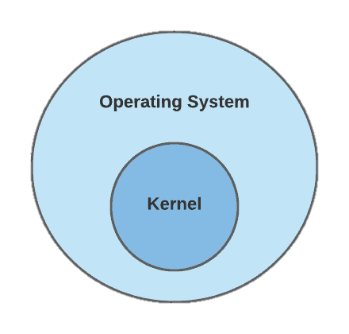
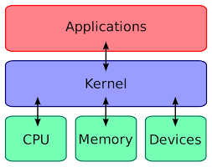
What is kernel?
Kernel is a part of operating system.
Lowest layer of operating system.
Kernel acts as a interface between hardware and processes of computer (applications)
The kernel loads first in memory after operating system has been loaded and reminds in memory until the operating system is shutdown.

Slide 4
What is kernel?
Functions of kernel
Device management
Memory management
Task management
Process management
Kernel provides services to all other parts of operating system.
Memory is divided into 2 part
User space (All applications will be get executed)
Protected kernel space (device, process, task, memory management)(invisible to the user)(no other application can access this place)

Slide 5
What is System Call?
System call will act as an interface between software applications and kernel.
System call provides the services of operating system to the process via API (application process interface)
When the process is being executed & it requires any resource, then the process will create a system call (interrupt) and sends to the kernel. And by execution the system call the kernel will give the resource to the process.
User Applications
System Call
Kernal
Hardware

Slide 6
What is System Call?
System call are the only entry points to
kernel space, no other applications can access
to the kernel space.
Kernel provide the services that mean resource
and that resource must be required by the
user space that is called system call.
User Applications
System Call
Kernal
Hardware

Slide 7
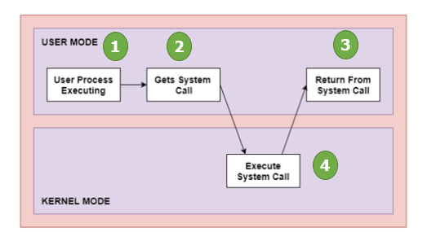
Workings of a System Call in OS
Following are the steps on how a System Call works:
Step 1: The processor executes a process in the user mode until a system call interrupts it.
Step 2: Then on a priority basis, the system call is executed in the kernel mode.
Step 3: After the completion of system call execution, control returns to user mode.,
Step 4: The execution resumes in Kernel mode.
System call table
Based on priority

Slide 8
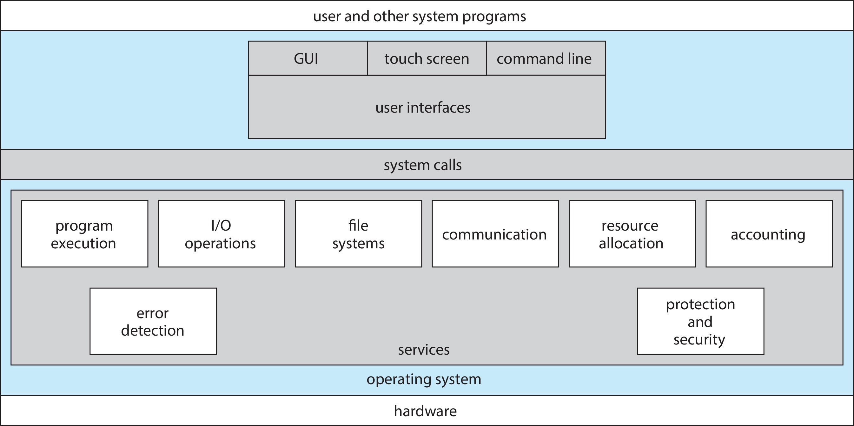
A View of Operating System Services

Slide 9
Types of System Call
Process control
Responsible for process management
create process, terminate process
File management
Responsible for file manipulation
create file, delete file
open, close file
read, write, reposition

Slide 10
Types of System Call
Device management
Responsible for Device manipulations
Writing data to buffer
Reading data from buffer
request device, release device
read, write, reposition
Information maintenance
Responsible for information being shared between process, operating system.
get time or date, set time or date
get system data, set system data
get and set process, file, or device attributes

Slide 11
Types of System Call
Communications
Responsible for IPC (inter process communication)
create, delete communication connection
send, receive messages if message passing model to host name or process name
Protection
Control access to resources
Get and set permissions
Allow and deny user access

Slide 12
Activity
Q1: What is the purpose of system calls?

